Slide 1
P01
Stress Test-based Smart Heart Condition
Monitoring System
Zhang Ziheng
Li Jisen
2022.07.28

Slide 2
P01
1
Background Introduction
2
Project Development Process
content
3
Display of Results
4
Future Expansion
CONTENT

Slide 3
Part one
01
Background introduction

Slide 4


Total number of cardiovascular patients in China
2020
290 million
2021
330 million
Significant
to monitor our heart condition

Slide 5

Expensive for a heart check in the hospital
A comprehensive cardiac
examination in Beijing
500+ CNY

Slide 6

A simple but effective method needs to be proposed
Simple and easy to operate
Results are easy to understand
Easy to use, especially at home

Slide 7
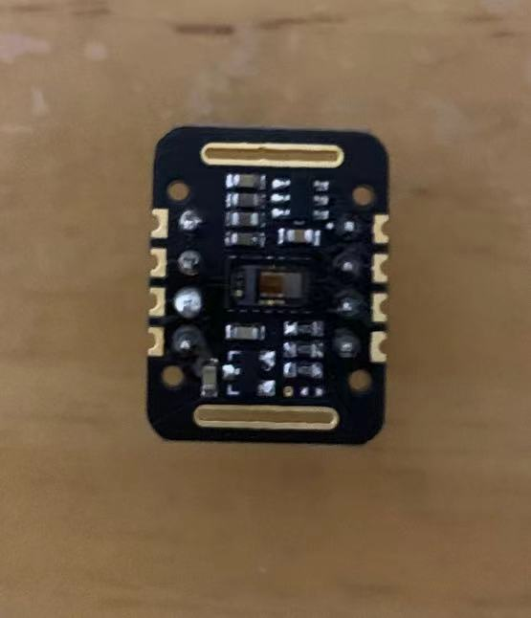
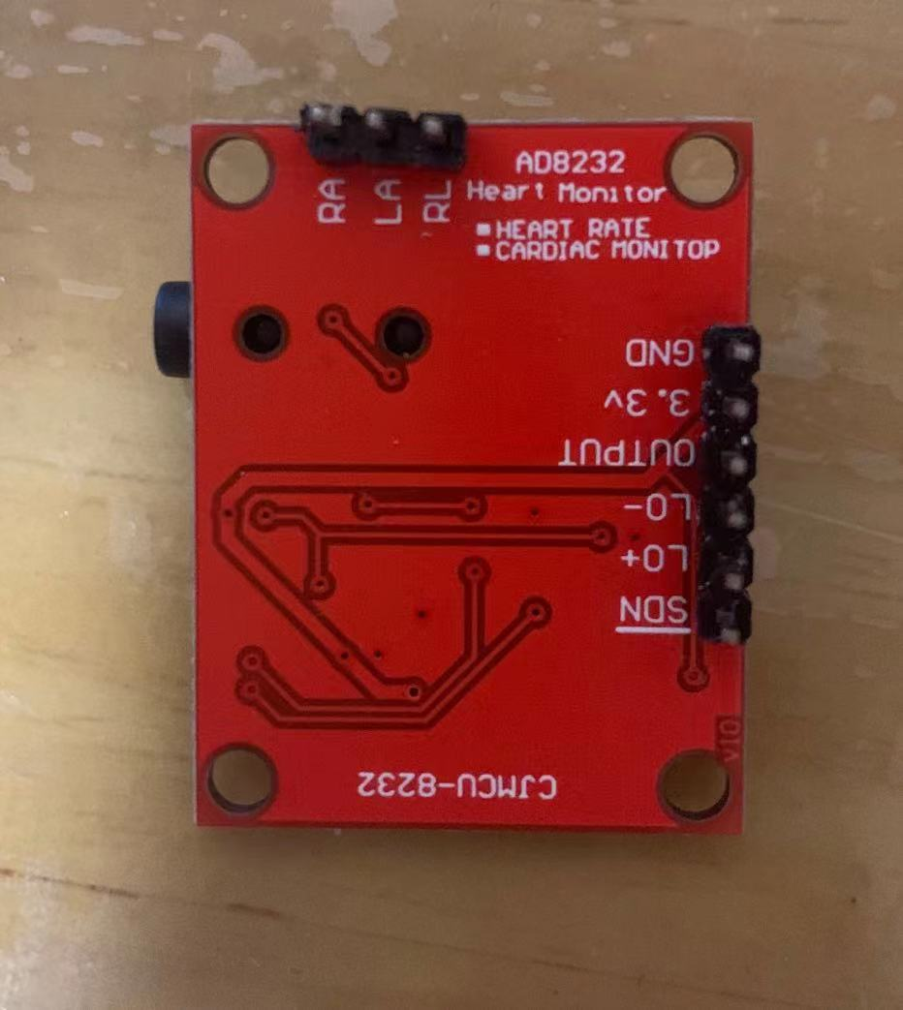


Contact Heart
Rate Detection
Contact Blood
Oxygen Detection
ECG Signal
Detection
Contactless Heart
Rate Detection

Slide 8
Part two
02
Project Development Process

Slide 9
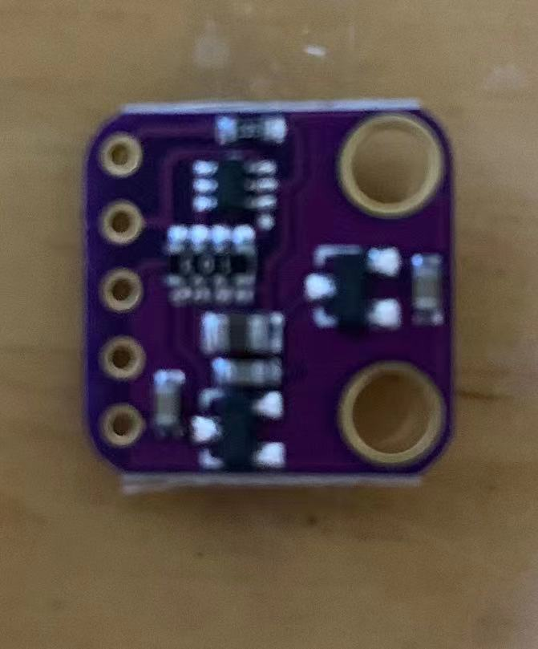
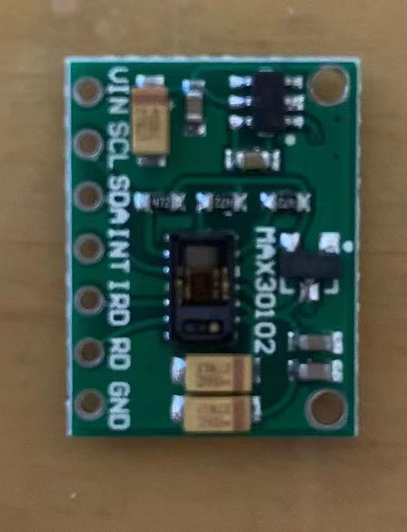
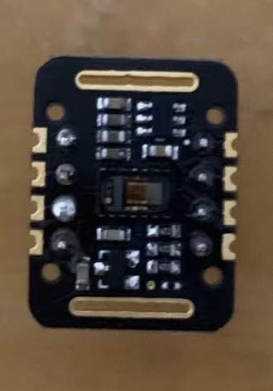

Project Development Process
Choose the right sensors
MAX30100
max30102 from different manufacturers

Slide 10
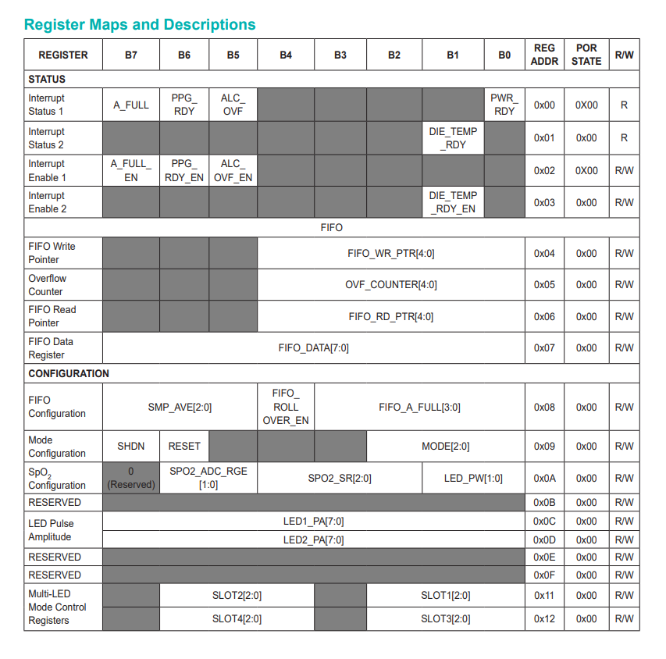
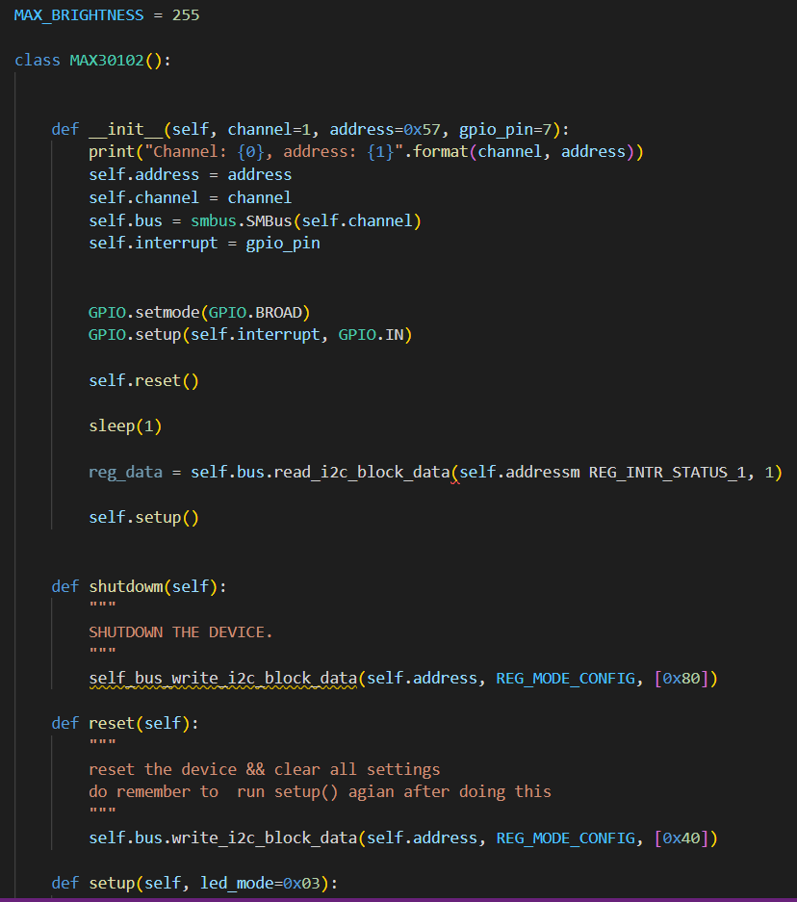
Project Development Process
Configure the appropriate registers

Slide 11
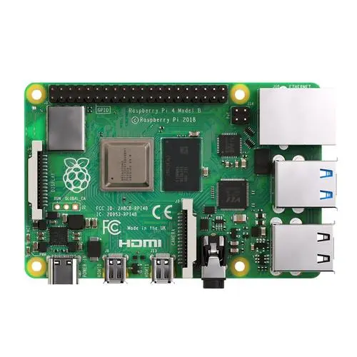
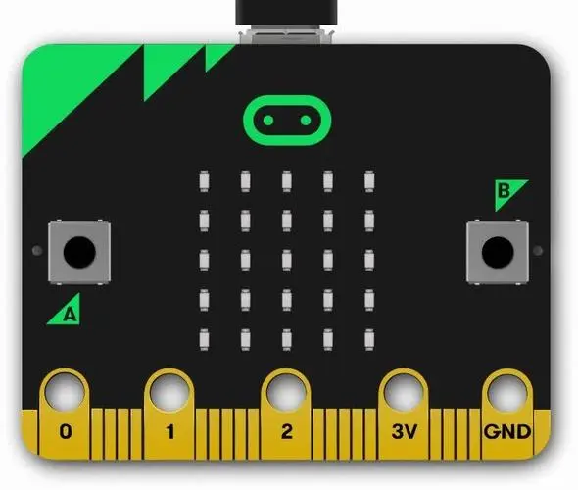
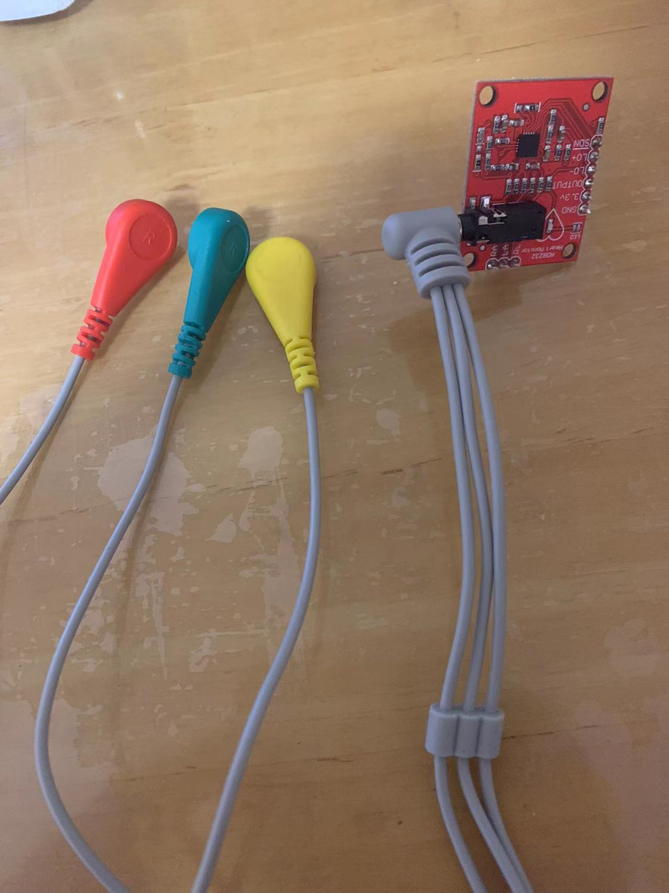
Project Development Process
AD8232 for measuring ECG signals
Connect to human
electrodes to obtain
ECG signals
A/D conversion

Slide 12
Project Development Process
Prediction program based on tensorflow
Train using the Cleveland dataset
Contains several convolutional layers and three fully connected layers
The user enters three parameters and the sensor collects three parameters

Slide 13
Part three
03
Display of Results

Slide 14
Part four
04
Future Expansion

Slide 15
Future Expansion
Complete the UI interface and database for user convenience
Extend the parameters collected by the sensor
Expand or prune the model to improve prediction accuracy

Slide 16
P01
thanks for watching
Zhang Ziheng
Li Jisen
2022.07.28

